Slide 1
Computer Systems, Data Structures & Data Management
Vassilis Markos
Mediterranean College
Week 15

Slide 2
A Quick Revision

Slide 3
What we last time… 1 / n
Which are the key steps in DB design?
There are four key steps:
Data-needs specification;
Conceptual-design phase;
Logical-design phase;
Physical-design phase.
Which are the two main sources of problems we avoid when we carefully design our DB?
Redundancy (i.e., information repetition) and incompleteness (i.e., missing information).

Slide 4
What we last time… 2 / n
What types of attributes are there, with respect to values count?
There are:
single-valued attributes;
multivalued attributes;
derived attributes.
Right or Wrong? A single-valued attribute takes a single value for all instances of an entity.
Wrong. It takes a single value for each instance, potentially a different one.

Slide 5
What we last time… 3 / n
What is “cardinality” in data modelling?
The number of entities to which another entity can be associated through a relationship set:
one-to-one;
  one-to-many;
  many-to-many.
Name two benefits of data normalisation.
Through data normalisation one avoids repetition of data as well as cases where some specific information cannot be represented in the DB.

Slide 6
(Reminder) DB Design Guidelines

Slide 7
Some Guidelines by MS 1 / n
Organizing data: Once you have an idea of the data you would like to collect, you need to decide how many tables you might want to use to organize the data efficiently. In Excel, we might keep several numbered columns to keep track of things, i.e. Medication1, Medication 2…, but in Access we should create a second table to track the numbered fields.
No Derived Fields: By using the relationships between our datasets, we can derive missing data. If we are creating a new appointment for a patient, we only need to put in their Medical Record Number (or other unique identifier). The patient's name, phone number, and other information can be derived from the Patient Table.

Slide 8
Some Guidelines by MS 2 / n
Data is broken down into Smallest Logical Parts: Pulling fields together in Access is often simple; pulling them apart usually requires human intervention. Think of this as breaking up the data into its smallest sort‐able part.
Descriptive Field Names: It's tempting to use abbreviations when we are creating our data tables, but if the title we use is too vague or too abbreviated we may not be able to recall why we created that field. DOB – Date of Birth or Department of Babies? SSN – Social Security Number or Shands System Number?

Slide 9
Some Guidelines by MS 3 / n
Unique Field Names: Be sure to differentiate between the field names in each Table. We can have a 'First Name' in our Patient Table and a 'First Name' in our Doctor Table but this can lead to confusion when we try to pull both Tables into one database object.
No Calculated Fields: In Microsoft Excel, we can perform our calculations on the same sheet as our data, but a Table in Access is stagnant data, it does not change unless you make it change. Access will let you create calculations in Queries, Forms and Reports. Newer versions of Access do have a Calculated field type for the table. This embeds a calculation in the record and is not always reflected in a data entry form.

Slide 10
Some Guidelines by MS 4 / n
Unique Records: It's important that each Table has a way to keep records unique. We can do this by setting one field (column) to be a Primary Key field. When a field is set as a Primary Key, Access will not allow any duplication nor blanks. When there is not a unique field in your data set, you can use an AutoNumber. AutoNumbers are incremented or random fields that are always unique.

Slide 11
The Almighty ER Model

Slide 12
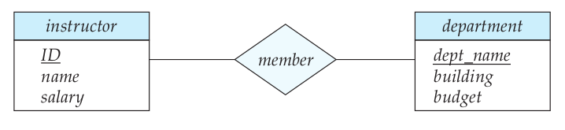
(Reminder) The E-R Model 1 / n
Entity set: The set of all entities, i.e., of all “things” in our application scenario.
Relationship set: The set of all relationships among entities, e.g., an instructor of the XYZ University is a member of one of its departments.
Unified Modeling Language (UML) is a common way to represent E-R models:
Relationship
Entities

Slide 13
(Reminder) The E-R Model 2 / n
Entities are described by attributes.
Attributes have values.
Attributes also have domains, i.e., sets of permitted values they can take:
  single-valued attributes, which admit one value at a time;
  multivalued attributes, which admit potentially many values at a time (e.g., one’s phone numbers).
  derived attributes, which are determined by other entities (e.g., attending students, which represents the number of students in a certain course).
Attributes can be simple or composite (comprising of other attributes).
“Single” and “multi” in the above refer to a specific instance of an entity and not the entity in its entirety.

Slide 14
Why go ER Diagrams?
Easier identification of relationships.
Easier table construction and connection.
ER diagrams are easy to translate to relational tables.
Can be used as a blueprint.
Higher level abstraction -> easier understanding of what’s going on in the DB.
Therefore, ER Diagrams make it easy to explain your DB to end-users.

Slide 15
Key Symbols and Notation
Rectangle: Entities
Ellipses: Attributes
Diamonds: Relationships
Lines: Connect attributes to entities and entities to relationships
Underlined text: Primary keys
Double ellipses: Multivalued attributes
Double rectangles: Weak entities
Double diamonds: Weak relationships

Slide 16
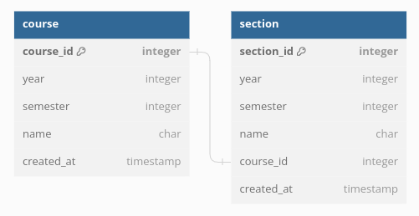
Weak Entities 1 / n
Open https://dbdiagram.io/d and draw the following diagram. Are there any problems with this design?

Slide 17
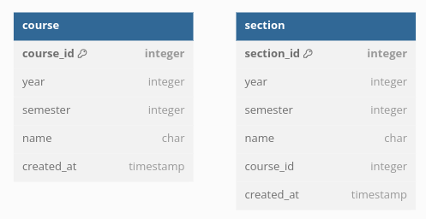
Weak Entities 2 / n
One dummy way to remove redundancy is by removing the relation between the two. But, where’s the problem now?

Slide 18
Weak Entities 3 / n
Since a section’s existence is dependent on a course, why not make section a “sub-entity”.
This idea is captured by weak entities, which are those entities whose attributes do not suffice to form a primary key.
In our case, we remove the course_id attribute from the section table and create a so-called weak relationship (the identifying relationship) which provides that information for each section.
Weak entities are distinguished by their discriminator (or, partial key), i.e., those attributes that can help us discriminate between two weak entities linked to a particular strong entity.

Slide 19
Weak Entities 4 / n
Is there any other way, avoiding weak entities?
Of course! For instance, we could have declared that section_id is unique across our DB, so all sections would be uniquely identified by that.
But, then, why do we use weak entities in this case, instead?
Because sections in our example could not exist without a corresponding course, hence it is conceptually easier to structure our DB that way.

Slide 20
Strong vs Weak Entities
Strong Sets | Weak Sets
Have primary key | Lack primary key. Have partial key
Represented by rectangles | Represented by double rectangles
Called “dominant entities” | Called “subordinate entities”
Are identified by their primary key | Are identified by their dominant entity’s primary key + their partial key
Strong relationships are indicated by single diamonds | Weak relationships are indicated by double diamonds
Connections are single lines | Connections are double lines

Slide 21
Back to the XYZ University
Consider the following simple scenario for the XYZ University:
Students enroll in courses.
Students are assigned to at least one course.
Each course is taught by a single professor.
A professor can only deliver one (and only one) course.
What process would you follow to design an ER Diagram for the above scenario?

Slide 22
ER Diagram Design
Five steps:
Entity Identification
Relationship identification
Cardinality identification
Attribute identification
ER Diagram creation

Slide 23
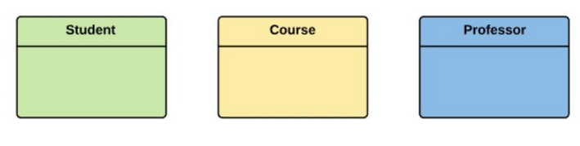
Entity Identification
In our case, we have the following entities:

Slide 24
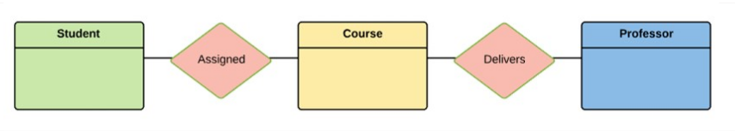
Relationship Identification
Then, we have the following relationships:

Slide 25
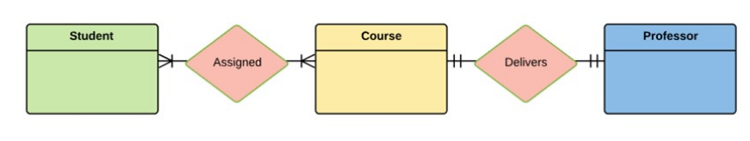
Cardinality Identification
In our case, relationships are shaped as follows:

Slide 26
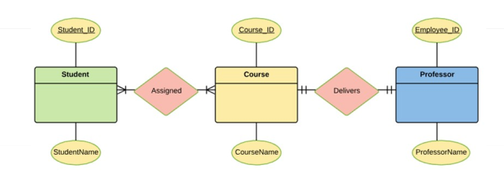
Attribute Identification
Regarding attributes, we could have a situation like the following ones. To add more attributes, we should have access to the files of the XYZ University to see what they usually store for all those entities:

Slide 27
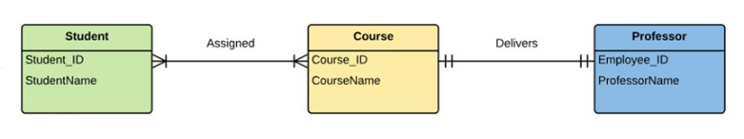
ER Diagram Creation
The final ER Diagram would look something like that:

Slide 28
Some Best Practices
Eliminate redundancies.
Proper entity and relationship labelling.
Include all data required (don’t miss any attributes, or, even worse tables or relationships!)
Each entity should appear exactly once!
Name everything!
Don’t connect relationships together!
Use colours!

Slide 29
Homework
Complete any unsolved yet exercises found in: ‘Week_03 > Derby Stuff > 5CC507_ER Exercises.pdf’.
No, there’s no catch, there’s nothing more for this week!

Slide 30
What we saw today… 1 / n
Name some reasons for using ER Diagrams.
Some such reasons are:
Easier identification of relationships.
Easier table construction and connection.
ER diagrams are easy to translate to relational tables.
Can be used as a blueprint.
Higher level abstraction -> easier understanding of what’s going on in the DB.
Therefore, ER Diagrams make it easy to explain your DB to end-users.

Slide 31
What we saw today… 2 / n
Which are the key symbols and notation in ER Diagrams?
Key symbols and notation include:
  Rectangle: Entities
  Ellipses: Attributes
  Diamonds: Relationships
  Lines: Connect attributes to entities and entities to relationships
  Underlined text: Primary keys
  Double ellipses: Multivalued attributes
  Double rectangles: Weak entities
  Double diamonds: Weak relationships

Slide 32
What we saw today… 3 / n
What are weak entities?
Weak entities are those entities whose attributes do not suffice to form a primary key.
When should one prefer weak entities over other ways of structuring a DB?
The most typical case is whenever a certain entity’s existence is dependent on that of another entity. In such cases, the latter should be declared a dominant entity while the former a subordinate one.

Slide 33
What we saw today… 4 / n
How many steps does a typical ER Diagram design process include? Which are they?
There are five steps:
  Entity Identification
  Relationship identification
  Cardinality identification
  Attribute identification
  ER Diagram creation

Slide 34
Fun Time!

Slide 35
Lab
In case you have not completed the previous lab exercise (introduction to Access 2016), now it is time to do so!
Also, in case you have not completed the practice exercises from the previous time (‘Week_02 > Derby Stuff > Week2_Practise.7z’), now it is time to do so!
If you are done with any past duties, open ‘Week_03 > Derby Stuff > 5CC507_ER Exercises.pdf’ and follow the instructions therein.
For the drawing part, you might of course use:
  DBML
  pen and paper
  other drawing tools like https://erdplus.com/ or https://app.diagrams.net/

Slide 36

Any Questions?
Don’t forget to fill-in the questionnaire! (check right)
https://forms.gle/edpsrRjMWJwPtv3U9

